Slide 1
Kubernetes tutorial
INTRODUCTION

Slide 2
History
System administrators play a critical role in managing datacenters. They are responsible for configuring clusters, installing user applications, and continuously monitoring server performance. Their work involves multiple essential tasks to ensure the smooth and secure operation of the infrastructure. Below is an outline of a system administrator's typical daily responsibilities:
Installing necessary libraries
Installing user applications
Ensuring the healthy operation of applications
Performing server backups

Slide 3
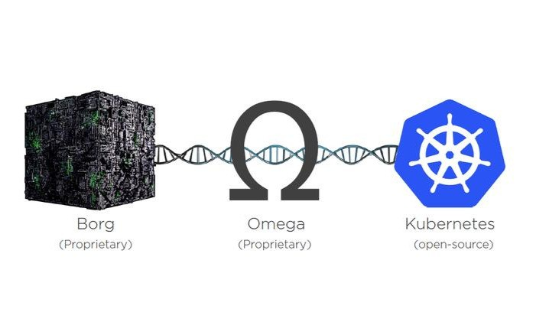
so we need automation

Slide 4
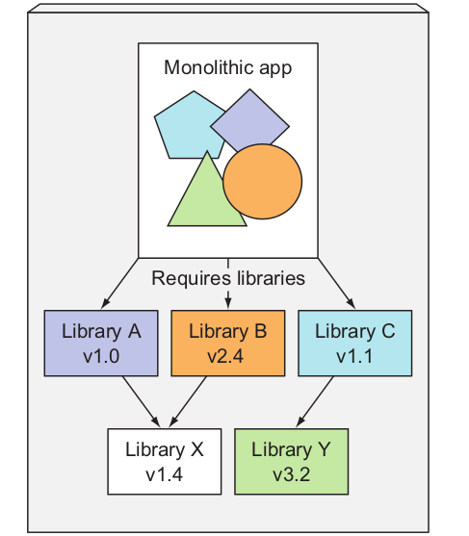
Some requirement
for running users application we need to install them first
isolation
application dependencies

Slide 5
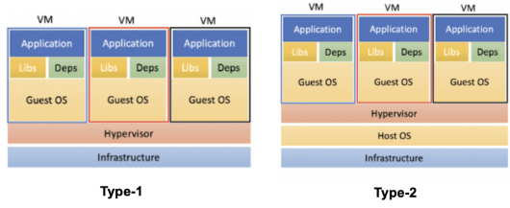
Some old solutions

Slide 6
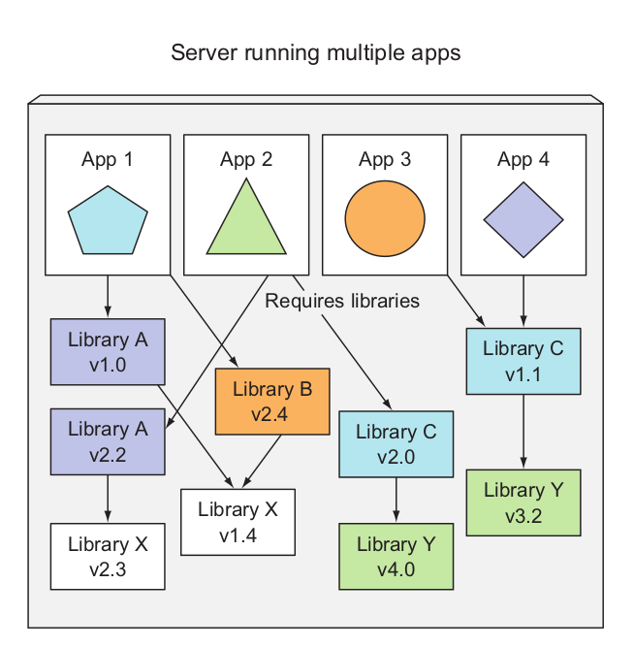
Microservices

Slide 7
linux projects
Several projects were initiated for Linux to isolate resources like process IDs (PIDs), network settings, and more.

Slide 8
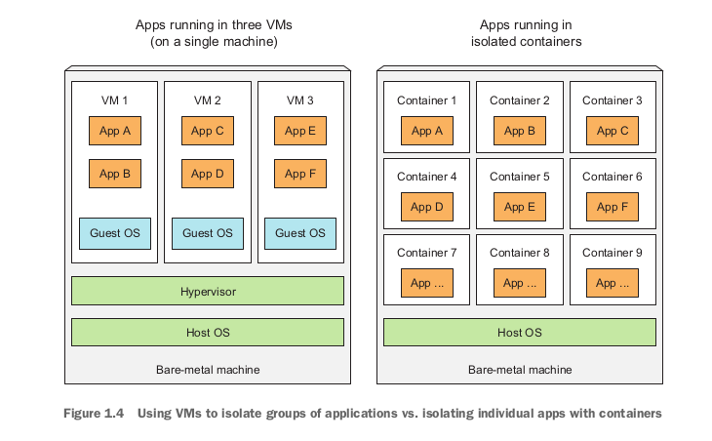

Slide 9
Docker
Docker is a platform for packaging, distributing, and running applications. As we’ve
already stated, it allows you to package your application together with its whole envi-
ronment. This can be either a few libraries that the app requires or even all the files
that are usually available on the filesystem of an installed operating system. Docker
makes it possible to transfer this package to a central repository from which it can
then be transferred to any computer running Docker and executed there (for the
most part, but not always, as we’ll soon explain)

Slide 10
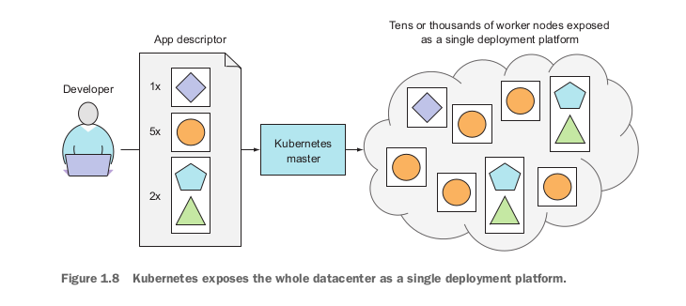
So What is kubernetes

Slide 11
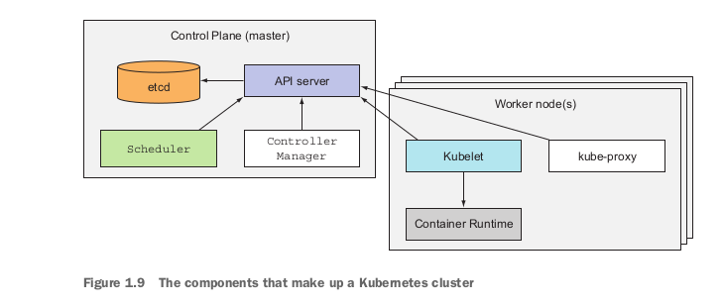
Architucture

Slide 12
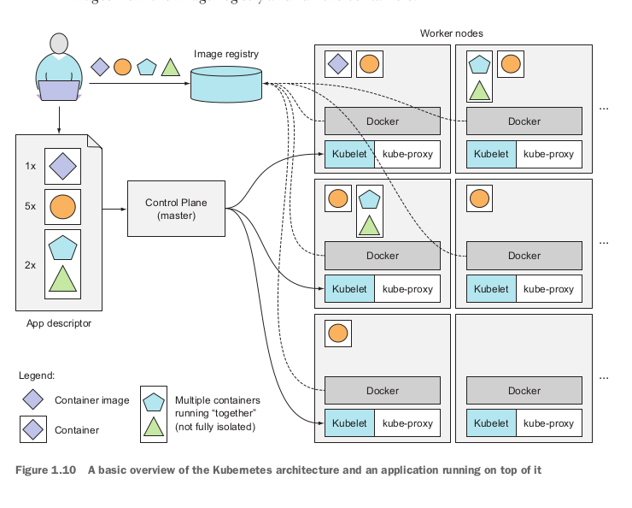

Slide 13
Kubernetes Tasks
SIMPLIFYING APPLICATION DEPLOYMENT
ACHIEVING BETTER UTILIZATION OF HARDWARE
HEALTH CHECKING AND SELF-HEALING
AUTOMATIC SCALING
SIMPLIFYING APPLICATION DEVELOPMENT

Slide 14
Thank you
Amir Hesari - 09152210069 - amir.hesari1848@gmail.com

